Slide 1
Experiments on basic segmentation methods
Zhixian Runhua

Slide 2
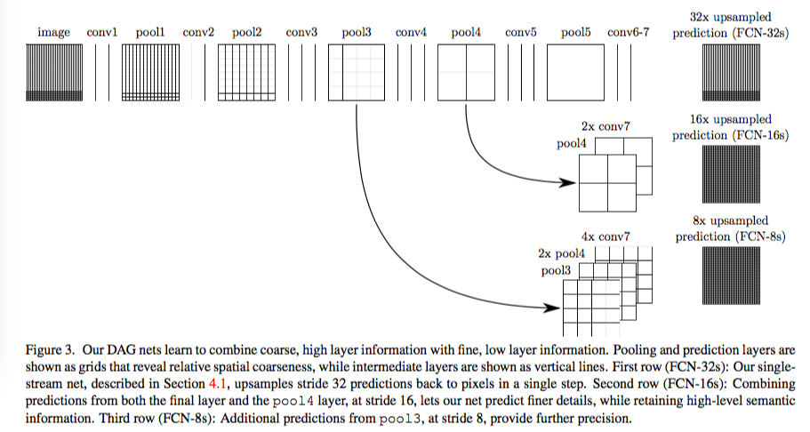
FCN

Slide 3
Experiments on FCN32s
Due to unbalanced dataset(too many background points), we set weights for crossentropy loss, trying to withdraw the influence of background points.
Weight1 = [1,1,1,…](1x44 tensor) Result: Acc=35.8 IoU=25.73
Weight2 = [0.5,1,1,…](1x44 tensor) Result: Acc=39.41 IoU=26.92
Weight3 = [0.1,1,1,…](1x44 tensor) Result: Acc=42.64 IoU=23.72
Weight4 = [0.01,1,1,…](1x44 tensor) Result: Acc=40.2 IoU=17.42

Slide 4
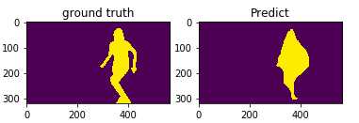
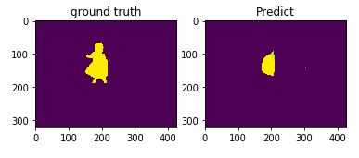
Results from FCN32s

Slide 5
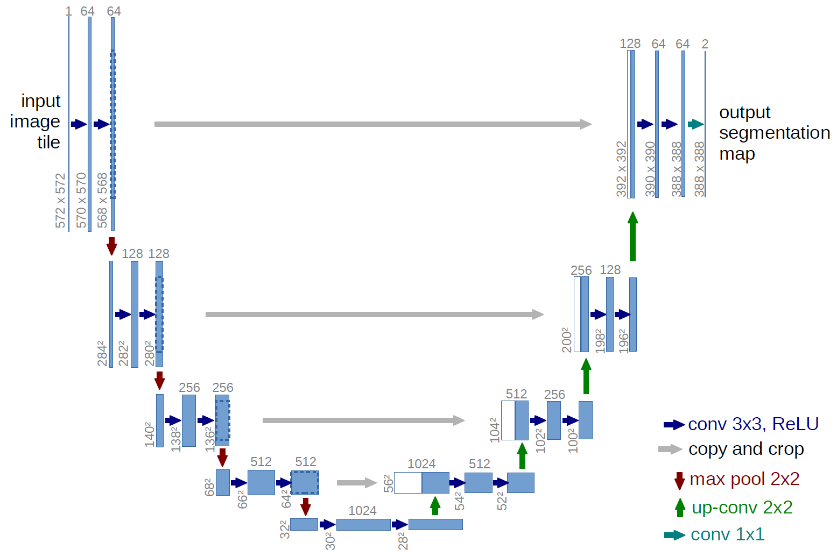
UNet

Slide 6
Something interesting
We tried dice loss(a measure of overlap widely) and crossEntropy loss.
Though dice loss works well in unbalanced dataset, it seems not working well in multi-class problems.
Original Unet will have gradient vanishing problems in this dataset. We find vanishing happen in 4th up layer, so we remove this layer’s activation function and then it works.

Slide 7
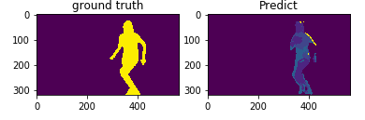
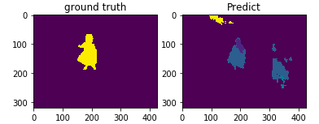
Results of Unet

Slide 8
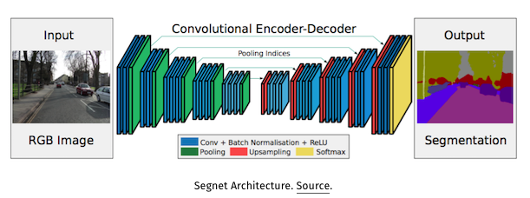
SegNet(lighter Unet)

Slide 9
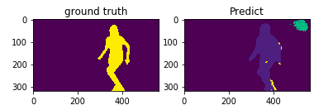
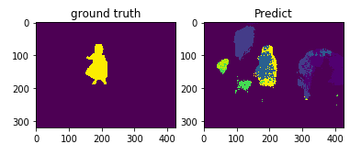
Results of SegNet

Slide 10
Ensemble
Combine two networks‘s results, trying to get a more diverse feature.
FCN’s pixel accuracy is better
SegNet’s shape is better

Slide 11
Ensemble SegNet and FCN32s
FCN32s
input
Ensemble
output
SegNet

Slide 12
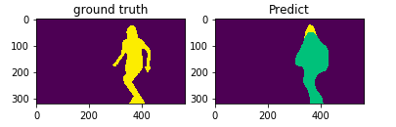
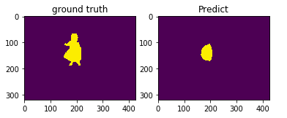
Results of ensemble

Slide 13
Some thoughts
Use CRF to do postprocessing
How about different resolutions inputs(since we actually upsample and downsample in FCN and SegNet)?
Due to unbalanced dataset, how about attention?

